Slide 1

CommUnity QR: Revolutionizing Delivery Services
CommUnity QR is a revolutionary platform that bridges communication gaps in delivery services, integrating QR codes and real-time translation to enhance security and customer satisfaction.

Slide 2
Desirability: Addressing Communication Gaps
Language Barriers
Order Accuracy
Seamless communication between delivery personnel and customers, regardless of their primary language.
Eliminating misunderstandings through clear, real-time translation of order details and instructions.

Slide 3
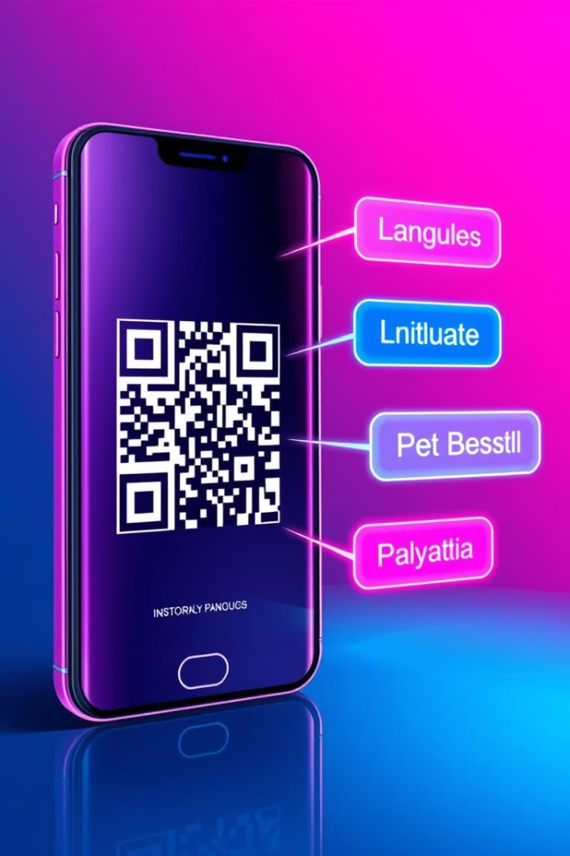
Feasibility: Integrated QR and Translation
1
QR Code Integration
2
Real-Time Translation
Leveraging QR codes for secure package tracking and delivery confirmation.
Utilizing advanced language translation technology to facilitate seamless communication.
3
Seamless Implementation
Easily integrating the solution into existing delivery workflows and systems.

Slide 4

Viability: Enhanced Security and Satisfaction
Secure Transactions
Improved Customer Experience
Ensuring the integrity of deliveries through tamper-evident QR codes and encrypted data.
Enhancing customer satisfaction by addressing language barriers and streamlining the delivery process.

Slide 5
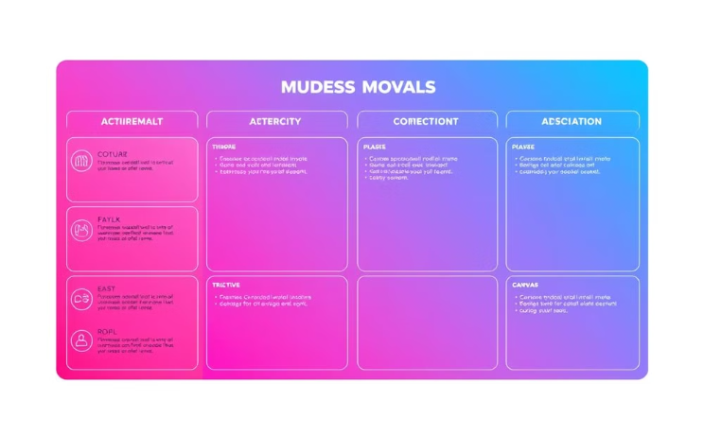
Business Model Canvas (BMC) One-Pager
Value Proposition
Seamless cross-cultural communication and secure delivery solutions for businesses and consumers.

Slide 6
Market Opportunity and Competitive Landscape
Market Opportunity
Competitive Landscape
Growing demand for innovative delivery services that address language barriers and security concerns.
Unique integration of QR codes and real-time translation sets CommUnity QR apart from traditional delivery solutions.

Slide 7
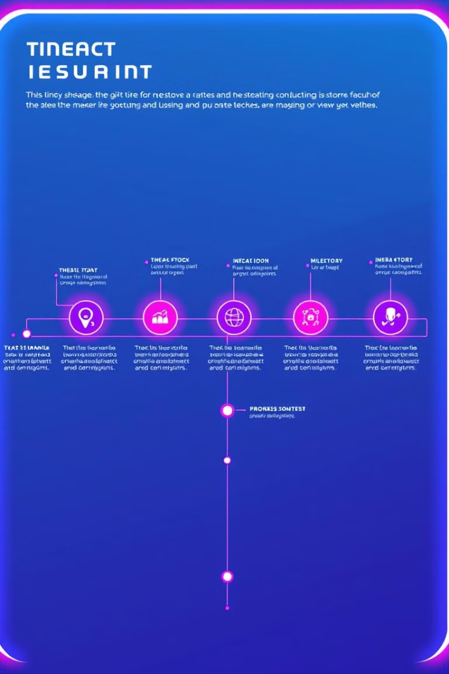
Roadmap and Key Milestones
1
MVP Launch
Initial release of the CommUnity QR platform with core features.
2
Pilot Partnerships
Collaborating with delivery companies to test and refine the solution.
3
Global Expansion
Scaling the platform to serve international markets and enterprises.

Slide 8

Our Next Steps: Scaling the QR Revolution
Secure Funding
Strategic Partnerships
Raise capital to accelerate product development and market expansion.
Collaborate with leading delivery providers to integrate CommUnity QR into their services.

